Slide 1
Woodland Public Schools
Facilities and Safety Report
October 2020

Slide 2
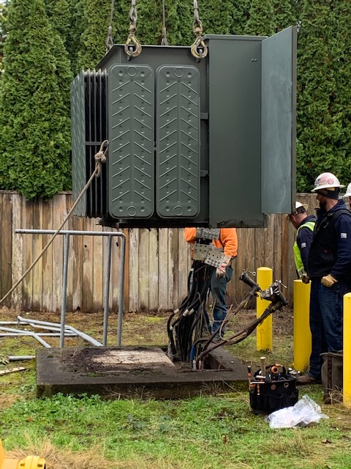
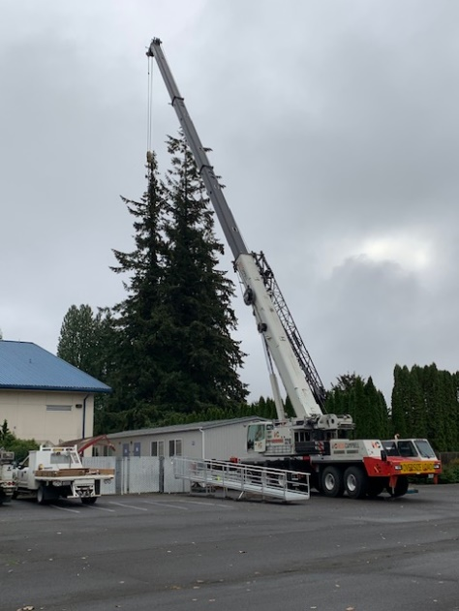
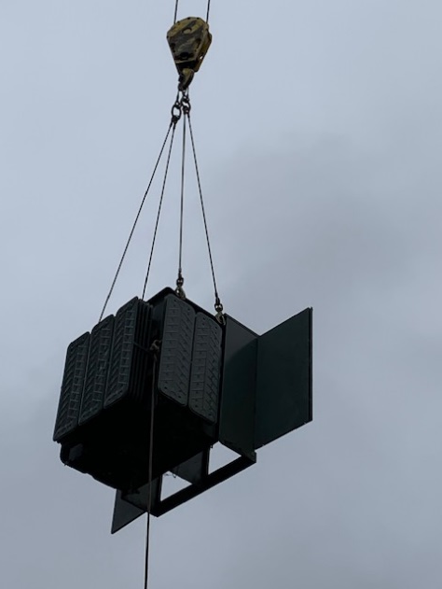
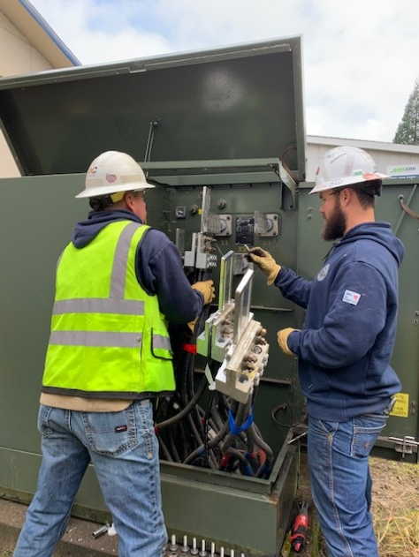
FACILITIES REPORT
Power Failure North Fork
The main power transformer to North Fork Elementary failed November 10th, forcing the school to go to full remote learning for the day. Cowlitz PUD was able to quickly source a new transformer in their yard and brought it to the school. The jib crane on the PUD truck was unable to lift the transformer off the trailer, due to the weight. The new transformer weighs just over 9000 pounds. We scheduled in a Ness/Campbell crane for Wednesday and completed the swap. We powered the school back up around noon. Unfortunately we found some damaged HVAC equipment as a result of the failed transformer “single phasing”, but we were able to get one of the HVAC system pumps operating. It is not unusual to see damage like this with this type of failure. Commercial transformer failures like this are very rare and we are assigning the failure to 2020!

Slide 3
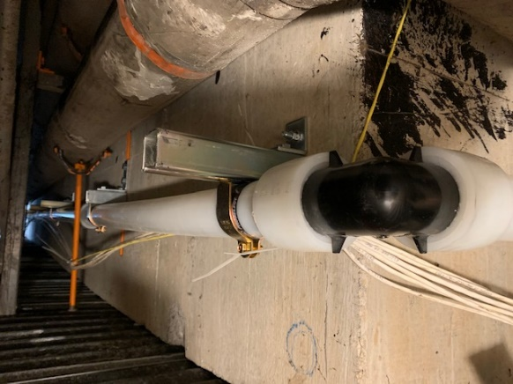
FACILITIES REPORT
New 2.5 inch PEX piping
In the utility tunnel
Water Piping Project We are finished with the section on piping that goes from the
gym mezzanine to the utility trench near the Middle School Office. The majority
of the piping work that will be done in the trench and mezzanine. The balance of the
work will be a line bore from the water meter on Park Street to the utility tunnel.
Team Portable After an exhausting month of negotiating, we were able to strike a very good deal with Modern Building Systems for a used portable that will provide expansion space for TEAM High School. Pricing was reduced by $10,200, which puts the cost squarely within the grant dollars. In the next few weeks, we will be breaking ground to the west side of the existing portable and prepping the site. This will include grading and setting gravel in for the building foundation. At this point, I’m hoping to have the building occupancy permits by the beginning of the year.
Bus Turnaround Bus traffic at Columbia Elementary has always been a problem. Cars zooming past buses while they are loading students, buses have to cross pedestrian crosswalk, and parent pick up traffic to leave the school. To remedy this, we will be adding a bus turnaround at the current loading zone that will allow the buses to go back the way they came and not impact the parking lot of Columbia Elementary at all. Once this is established, I will approach the City to see if we can gate off the gravel road completely. This will also end our younger drivers from “drifting” on the gravel corner!

Slide 4
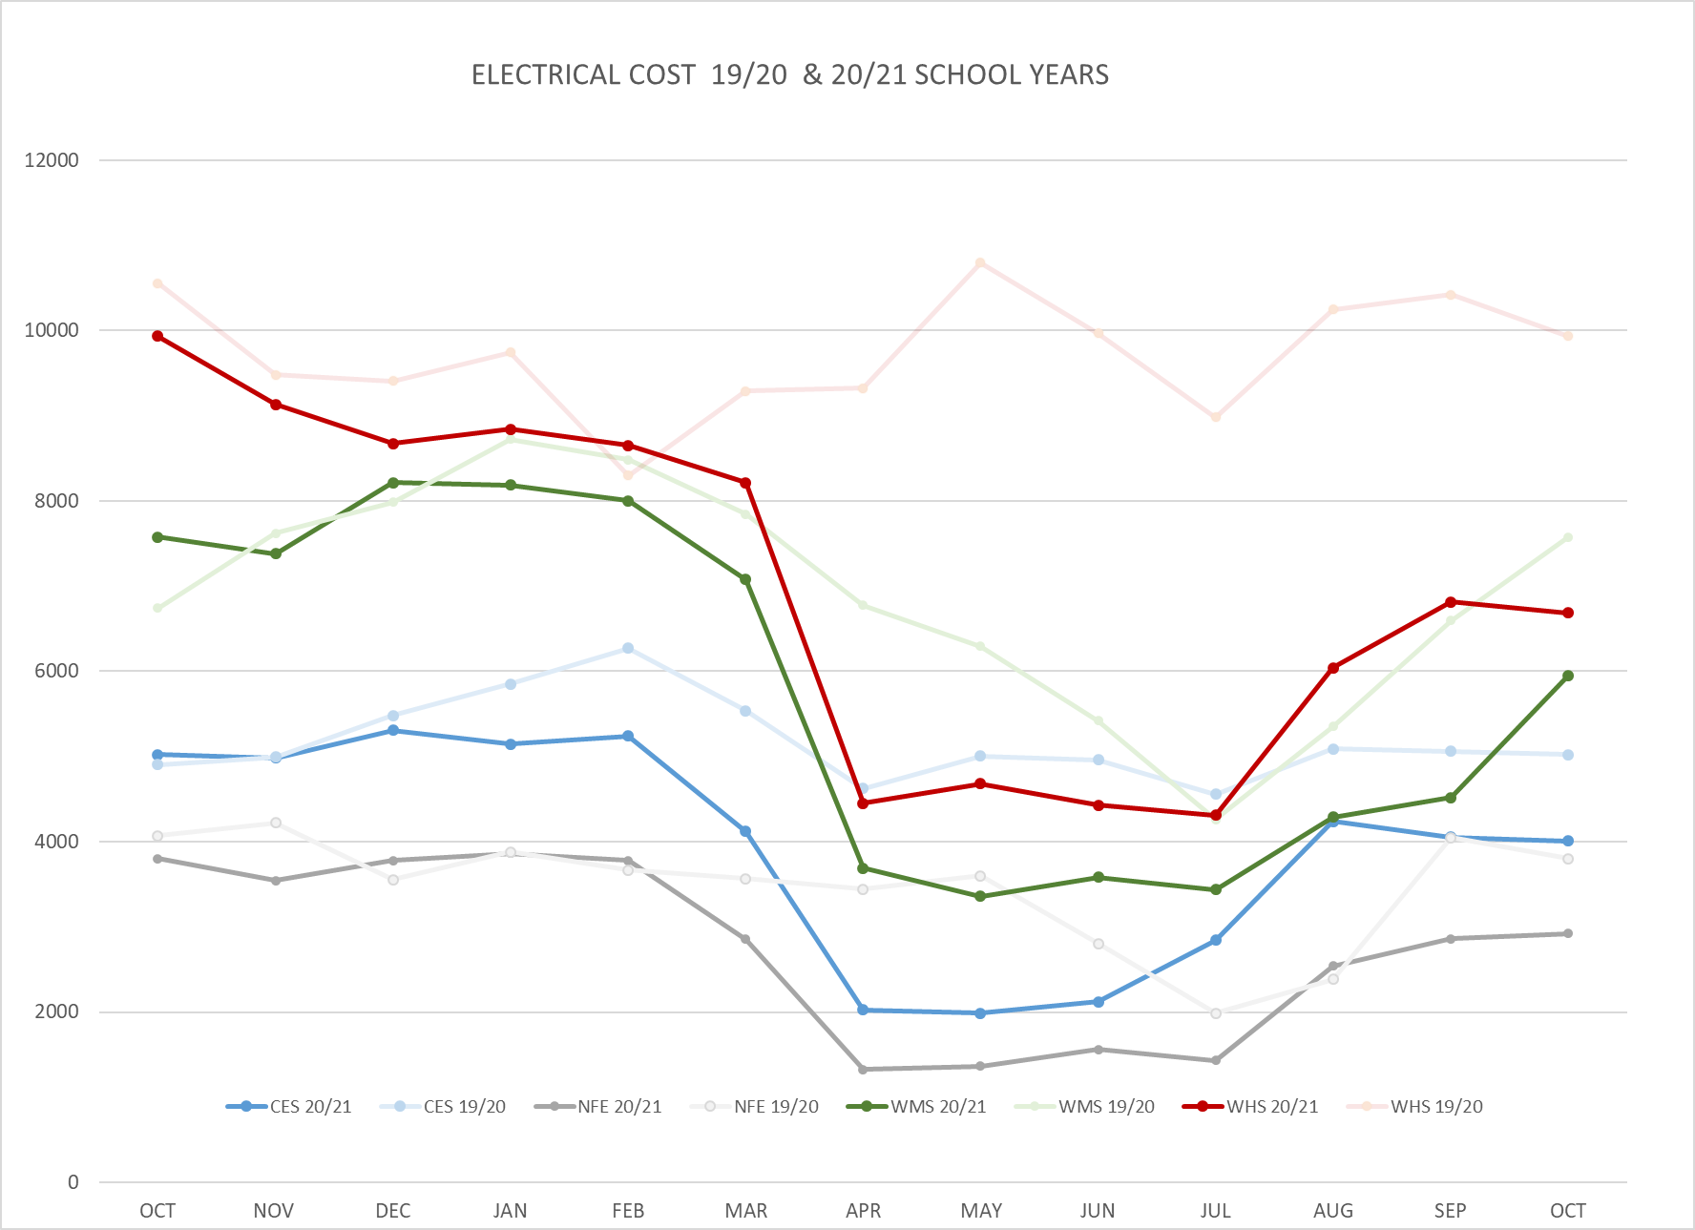
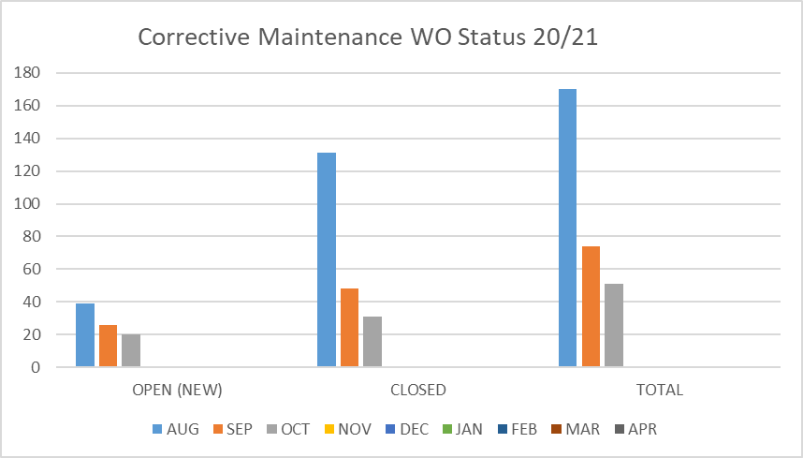
FACILITY CHARTS – POWER COST AND WORK ORDER STATUS

Slide 5
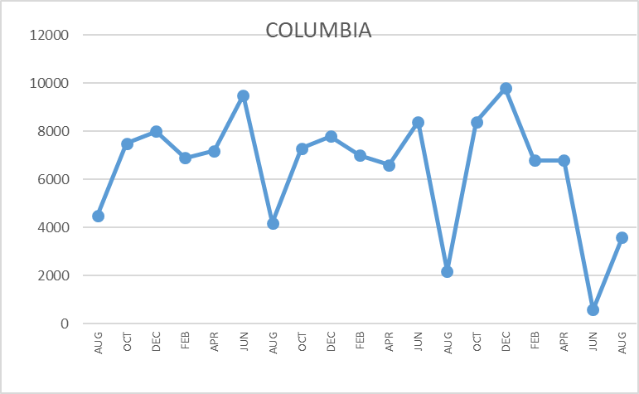
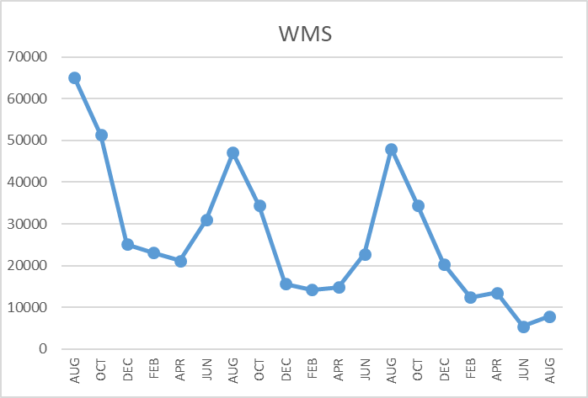
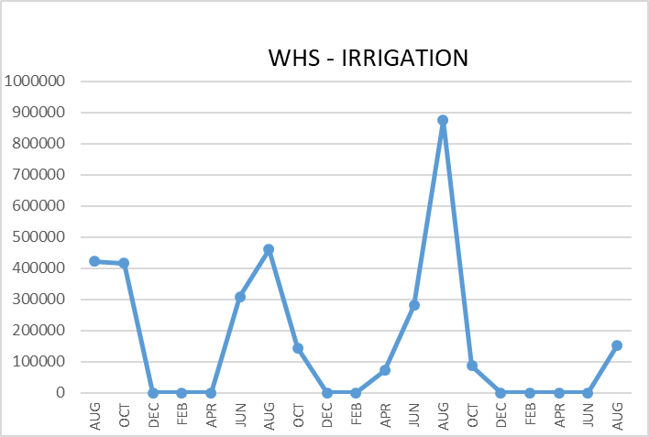
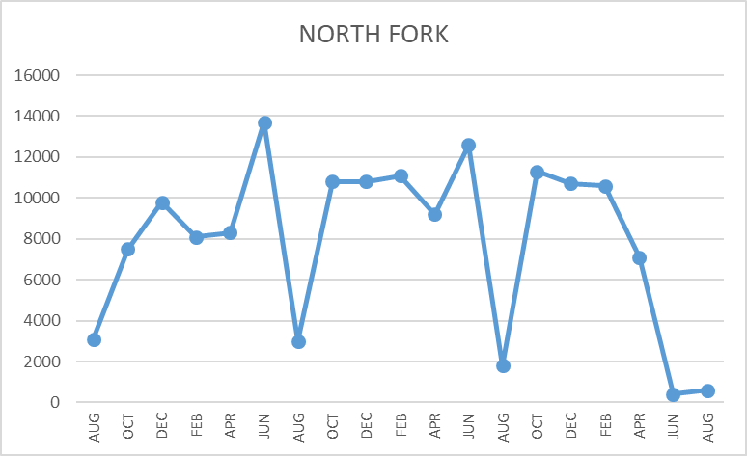
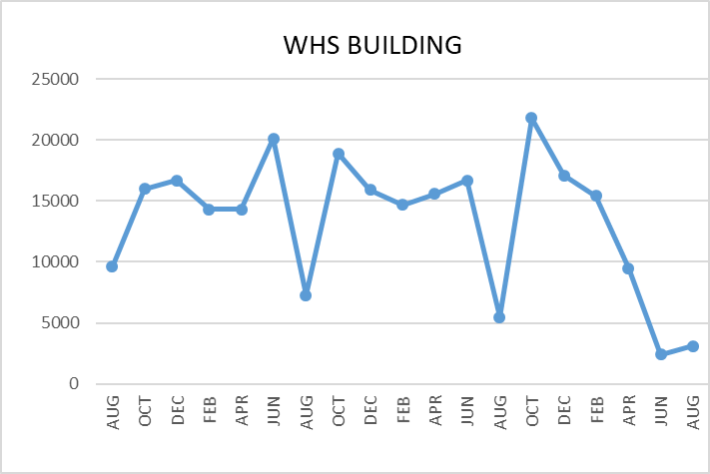
FACILITY CHARTS WATER USAGE WHS, NFES, WMS, CES
Note
Water charts are updated every two
months.
The WMS chart includes the following 7 meters: 755 Park high and low flow, BO and TEAM High, PIT house, bus barn, athletic field and DO. All of these meters are totaled on the WMS graph, but each data point is recorded separately to aid in identifying leaks.

Slide 6
Safety Summary
Staff Accidents/Incidents
One staff accident- numbing of fingers, thought to be associated with a carpal tunnel type injury.
Student Accidents/Injuries
No student accidents or incidents recorded.

